Slide 1

Network

Slide 2

Objectives
At the end of the lesson students should be able to
Describe what is a computer network
List types of network
Compare network types
Define the term topology
List the 4 main types of network topologies
State advantages and disadvantages of the identified network topologies
Compare network topology

Slide 3
What is a network
A network is a collection of computers and devices that are linked together so that they can communicate and share resources.
These devices may be computers, telephones or other communicating devices.
The computers are connected using different media like copper wires, microwaves, optical fibers and satellite Bluetooth, cables and Wi-Fi.

Slide 4
Advantages and Disadvantages of Network
List 5 benefits
5 disadvantages

Slide 5
Here are some of the main benefits of networking computers and devices (rather than using a number of stand-alone computers):
Devices, such as printers, can be shared (thus reducing costs).
Licences to run software on networks are often far cheaper than buying licences for an equivalent number of stand-alone computers.
Users can share files and data.
Access to reliable data that comes from a central source, such as a file server.
Data and files can be backed up centrally at the end of each day.
Users can communicate using email and instant messaging.
A network manager can oversee the network and, for example, apply access rights to certain files, or restrict access to external networks, such as the internet.

Slide 6
There are also a number of drawbacks:
Cabling and servers can be an expensive initial outlay.
Managing a large network can be a complex and difficult task.
A breakdown of devices, such as the file servers, can affect the whole network.
Malware and hacking can affect entire networks (particularly if a LAN is part of a much larger WAN), although firewalls do afford some protection in this respect

Slide 7

Types of Network
LAN
A local area network (LAN) is two or more computers connected directly within a small geographical area such as a room, building or group of closely placed buildings.
WAN
A wide area network is two or more computers that are geographically dispersed, linked by communication facilities such as telephone system or microwave relays.

Slide 8

Watch the video and answer the question on the next slide

Slide 9



Characteristics of a LAN
High quality cabling
Fast transfer rates
Few errors
Owned by the company
Users share hardware and software
Internal communication via e-mail

Slide 10
Characteristics of a WAN
Lower quality cabling
Slower transfer rates
Error prone
Line rented from a telecommunications company
Access to specialised databases
File transfer/sharing
Internal/external communication via e-mail

Slide 11
Network Model
Two main types of network model
Client–server networking involves a central, powerful computer called a server, and a number of client computers that need to connect to the server to carry out specific tasks.
In peer-to-peer networking, there is no central server. Instead, all the computers in the network have equivalent capabilities.

Slide 12
Client Server Model
A client and server networking model is a model in which computers such as servers provide the network services to the other computers such as clients to perform a user based tasks.

Slide 13
What is a Server?
A Server is a remote computer which provides information (data) or access to particular services. It runs a program that provides services to the clients. When the client requests for a service, then the server opens the door for the incoming requests, but it never initiates the service.
Servers are usually always on and connected to the internet, so that users can access their resources and services at any time

Slide 14
Types of Servers?
File servers: allows user to save and load data files.
Application server: deals with the distribution of applications software to each client/node/computer.
Print server: ensures that printing from devices on the network is done in queue.
Proxy server: acts as a buffer between WAN (usually internet) and LAN.
Web Server: A web server provides access to a web application.
Email server
Databased servers
Domain controller server

Slide 15
Peer-to-peer Network Operating Systems
allow users to share network resources saved in a common, accessible network location.
It does not have a central server, each of the nodes (workstation) on the network can share files with the other notes and each node will have its own data.
All devices are treated equally in terms of functionality. Peer-to-peer usually works best for small to medium LANs and is cheaper to set up.

Slide 16
Features of P2P Architecture
Self scalability: Each peer also adds a service capacity by distributing the files to the peer.
Cost-effective: It does not require significant server infrastructure and server bandwidth.
Resources such as files, printers, storage, bandwidth and processing power can be shared between various computers in the network.
Easy to configure. Once it’s set up, access is controlled by setting sharing permissions on each computer. Stricter access can be controlled by assigning passwords to specific resources

Slide 17
Advantages Disadvantages
Security
No Central storage
Backup
The performance will be slowed as many peers are accessing it at the same time.
Easily to transfer copyrighted content like movies and music by implementing torrents.
Speed of Internet connection can affect while uploading and downloading simultaneously
Easy file sharing
Reduced costs
Adaptability
Reliability
High performance
Efficiency

Slide 18
How the Peer to Peer Network works?
Research and present to the class your finding

Slide 19
What is a Client?
A client is a computer or computer-controlled device that provides a user with access to a network.
Clients run software to make requests to the servers, and either interpret or display the responses.
A client sends a request to the server. The server processes the request and then sends a response to the client.
Clients do not hold the power to force a server to respond to a request.

Slide 20
Types of Clients
Thin Clients;-A thin client is a computer system that runs on a server-based computing environment. They work by connecting to a remote server-based environment, where most applications and data is stored.
Thick Clients: It is a form of client-server architecture that has most resources installed locally, rather than distributed over a network.

Slide 21
Advantages of thick clients
Portability.
No lag due to a poor connection.
The ability to store and access data on a hard drive or SSD.
A higher server capacity.
Server connection.
More flexibility.

Slide 22
Disadvantages of thick clients
Security.
Data storage.
Investment into each client.
Maintenance.
Network traffic.
New applications.

Slide 23
Comparison Thin and Thick Clients
Thin Client | Thick Client
Thin client is a lightweight computer that relies on the resources of the host computer. | The thick client relies lightly upon the server and provides rich functionality.
In thin client, data is stored in servers. | In thick client, data is stored locally.
In thin client, a fast and robust network connection is required. | It can work with a slow network connection.
There is no offline working. | Offline working is possible in thick client.
The deployment is easier in thin client. | Unlike the thin client, the deployment in thick client is expensive.
In thin client, the data verification is done at server side. | In thick client, the data verification is done at client side.
It generally consumes less local resources. | Unlike thin client, it consumes more local resources.
In terms of security, they are more secure than thick clients as they have fewer security threats. | In terms of security, they are less secure than thin clients as they have more security threats.

Slide 24
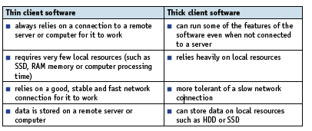
Comparison Thin and Thick Clients: Software

Slide 25
Activity
In your note books write answers to the following
A company has 20 employees working on the development of a new type of battery for use in mobile phones. Decide which type of network model (client-server or peer-to-peer) would be most suitable. Give reasons for your choice.
Another company is made up of a group of financial consultants who advise other companies on financial matters, such as taxation and exporting overseas. Decide which type of network model (client-server or peer-to-peer) would be most suitable. Give reasons for your choice.

Slide 26

NETWORK TOPOLOGY

Slide 27
Network Topologies
Computer networks vary in their physical topologies or how the devices in the
network (called nodes) are arranged.
Types
Star
Bus
Mesh
Hybrid

Slide 28
Watch the video and note the salient points

Slide 29
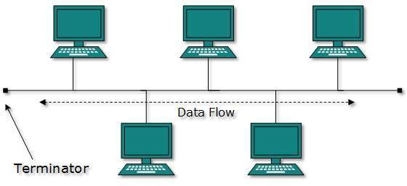
BUS
In a Bus topology, all computer devices are connected through a single cable that is known as a backbone cable.
Each device is directly interconnected to the backbone cable.
Bus topology is easy to installation compared to another topology. It sends data only in a single direction.

Slide 30
BUS TOPOLOGY
Advantages
It is cost effective.
Used in small networks.
It is easy to understand.
Easy to expand joining two cables together.
It is very simple to install.
It is less cable required to connect the devices compared to other topology.
Disadvantages
If the main cable fails, then whole network fails.
If network traffic is heavy or nodes are more the performance of the network decreases.
Cable has a limited length.
It is slower than the ring topology.
Complicated reconfiguration and fault detection.

Slide 31
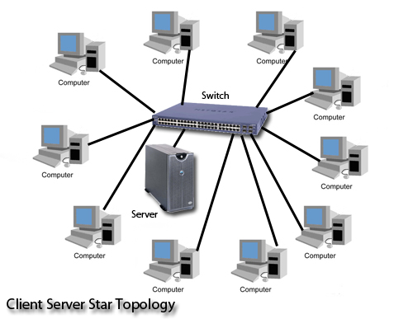
Star Topology
A star topology, all device in the network is connected to a central device known as a Switch or Hub or Host Computer.
The host computer is directly connected to each device.
The host computer controls all devices. It has using Point to Point connection.
If a device wishes to send data to another device, it must first send the data to the host computer, and then the host computer sends that data to the other device. The host computer acts as a repeater for data flow

Slide 32
Star topology
Advantages
fewer cables are needed because each device only needs to be connected to a host computer or hub.
It is simple to troubleshoot.
If one device is a failed, so only that device is affected, and all the other devices are active.
Easy to detect failing devices because the device can be easily recognized.
Disadvantages
Depends on the host computer. If the host computer fails, then the whole network fails.
Expensive to use.

Slide 33
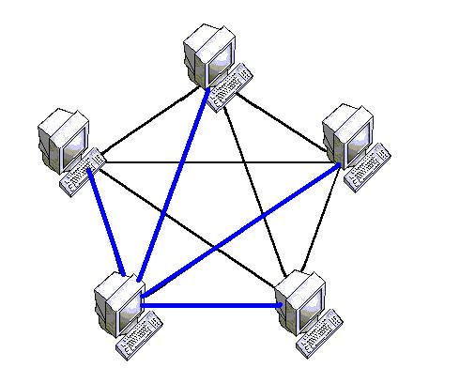
Mesh Topology
In a Mesh topology every node (Computers, Hubs, Switches, and any other devices) is connected with all the other nodes.
There is no hierarchy, uniform pattern, and interdependency between nodes and connections take place randomly. One device must be connected with (n-1) devices. A Mesh topology can be formed by using the formula:
Number of cables = (n*(n-1))/2
The Mesh topology works by using either the Routing or flooding principle.

Slide 34
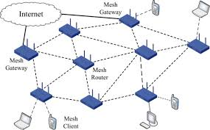
Mesh Topology
The Mesh topology works by using either the Routing or flooding principle.
In the routing mode, the data is transmitted in a predetermined path with multiple hopping across nodes before delivering data packets to the destination. In order to transmit the data over the network, all the intermediate nodes need to remain active and stay connected. If there is a failure in any of a node in the path, then another alternate path is used.
In the Flooding mode, the data is communicated to all the active nodes in the network. If a node finds that the data is addressed to it, then it accepts the data otherwise it passes it to the next node. The data pockets have a fixed life span this can either be fixed time period or the number of hops it can take before the data is removed from the network.

Slide 35
Mesh Topology
Advantages
It is very robust. If anyone’s connection gets damaged, they cannot affect others.
It provides more privacy and security.
It provides a dedicated connection between the devices.
It’s simple to detect the fault.
Disadvantages
The number of wires and the number of I/O ports required are very large.
Mesh topology is very expensive than the other topology.
It is difficult to install and configure

Slide 36
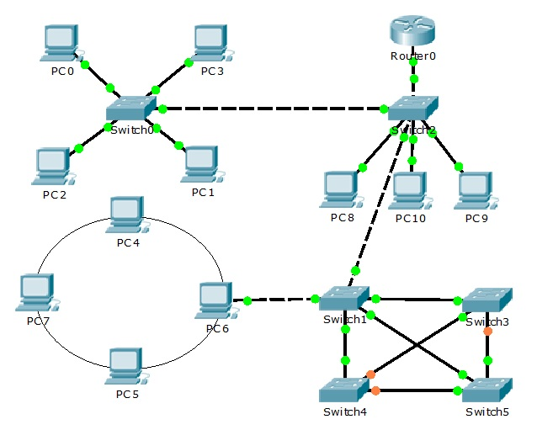
Hybrid Topology
A hybrid topology is a kind of combination of two or more different networking topologies. It involves a mixture of the tree topology, bus topology, ring topology, and mesh topology.
The choice and usage of hybrid topology depend on its requirements and deployments such as the number of servers, location, and the performance of the desired network

Slide 37
Hybrid Topology
ADVANTAGES OF HYBRID NETWORK TOPOLOGY
DISADVANTAGES OF HYBRID TOPOLOGY
Reliable : Fault detection and troubleshooting is easy in this type of topology.
Scalable: It’s easy to add new components.
Flexible: Can be designed according to the requirements of the organization and by optimizing the available resources
Effective: the strength of each used topology is maximized and its weakness reduced.
Complexity of Design: Its not easy to design this type of architecture
Costly Hub: The hubs used to connect two distinct networks, are very expensive.
Costly Infrastructure: As hybrid architectures are usually larger in scale, they require a lot of cables, cooling systems, sophisticate network devices, etc.

Slide 38
